Slide 1
FDP on Agentic AI: Foundations, Applications, and Future Directions
“Exploring the Power of Agentic AI with IBM Granite and LangFlow”

Slide 2


Name of the team: SKYMINDS
Details of Team members
TEAM MEMBER NAME | Recent Passport Photo | Email ID | Phone number [WhatsApp]

Slide 3

Travel Agent
The Challenge
Travel planning can be overwhelming, as individuals often struggle with:
Information overload – browsing multiple sites for flights, hotels, and activities.
Personalization gaps – generic suggestions that don’t match user interests, budgets, or travel styles.
Unreliable sources – scattered, inconsistent information about destinations, local culture, or safety.
Dynamic conditions – sudden changes in weather, transport schedules, or local advisories.
Without a reliable, intelligent assistant, travelers spend excessive time researching and still end up making suboptimal choices, leading to poor travel experiences, overspending, or missed opportunities.

Slide 4
Research work
Write your solution by text , diagram .We are using Agentic AI system . ….

Slide 5

Write your solution by text , diagram .We are using Agentic AI system . ….

Slide 6
Solution Overview
We are going to use Langflow platform . We are using IBM granite models .

Slide 7
Langflow component Used
Explain the use of each langflow component used into you project
1)Chat Input –
2) IBM watsonx AI Agent
File component
Chat output
Add name of any other component used.

Slide 8
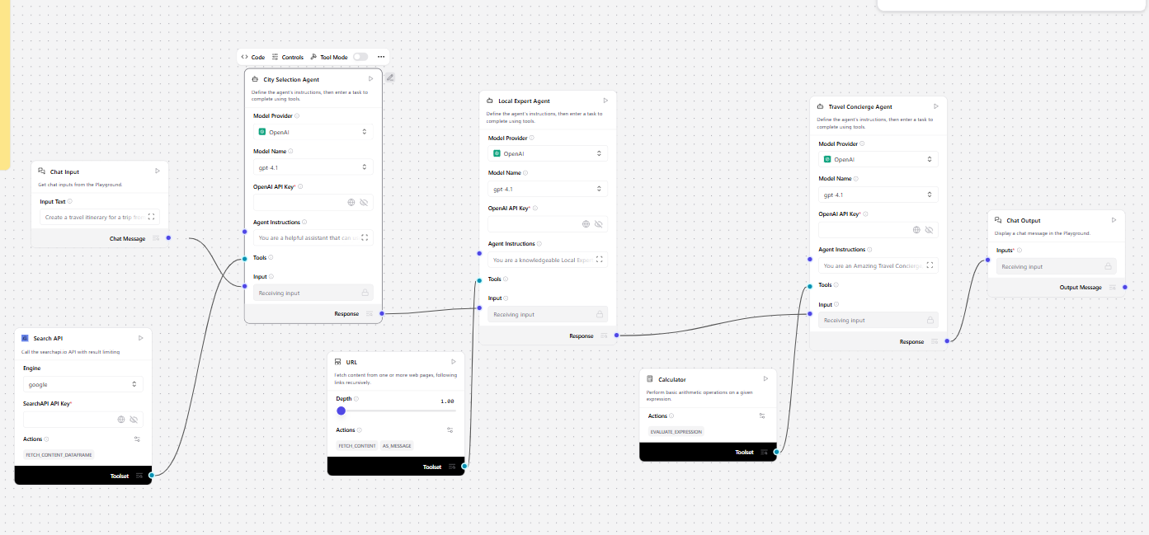
Workflow

Slide 9
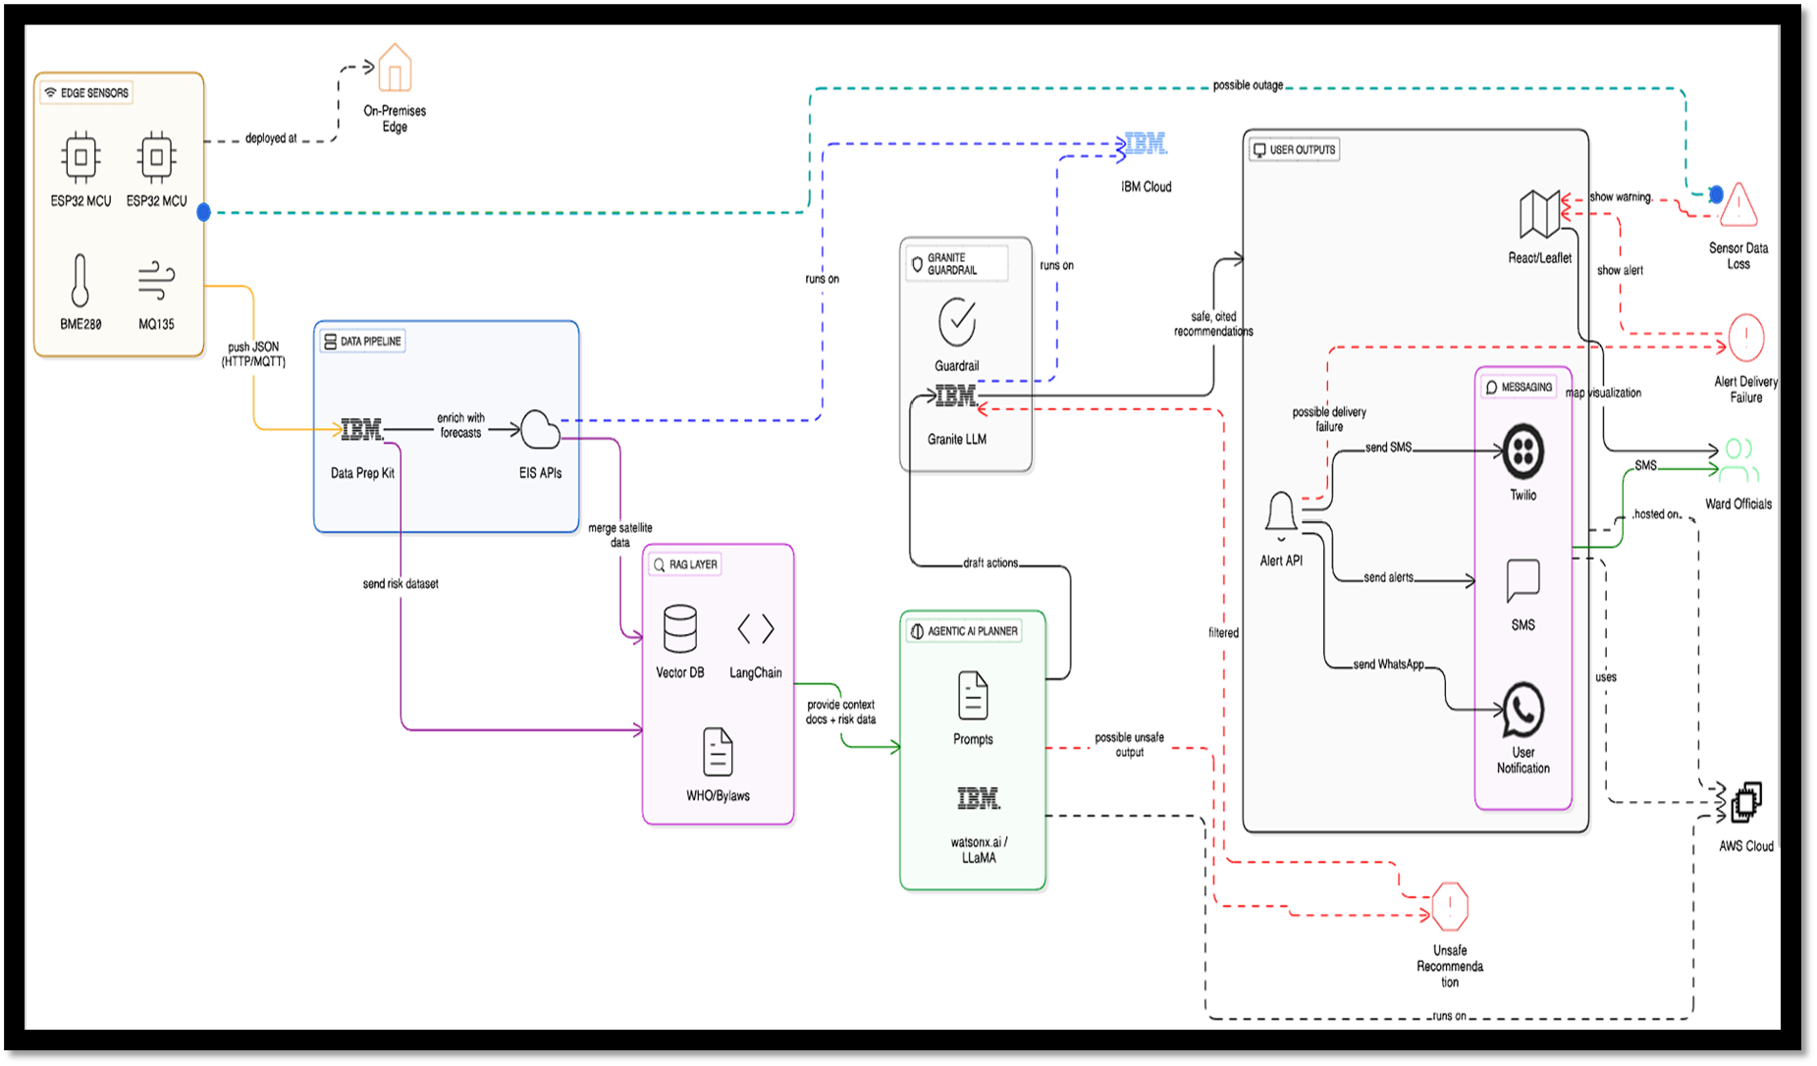
Architecture blueprint

Slide 10
Role of Agentic AI in your solution
Explain how Agentic AI help to find solution of the problem

Slide 11
Technology Used
Langflow platform
Langflow component name – Agent , Chat input , Chat output
IBM Grainte model - for eg – ibm-granite-3-2-8b
IBM Cloud
RAG if used
IBM Watsonx.ai
Watsonx

Slide 12
Novelty and Uniqueness
· First platform merging micro‑climate sensing, GenAI, and policy
retrieval for urban adaptation.
· Uses non‑wearable, rooftop nodes—cheaper and easier to deploy
city‑wide.
· Granite‑guarded outputs ensure bias‑free, regulation‑compliant
advice.
· 5‑second loop from sensor trigger to official alert.

Slide 13
Git Hub Link
· Please create public github repository (Enable Add README button while creating repository) with format –
Please test and Paste the working Github URL –
Make sure you have Uploaded following three files into your github repository
1) app.py file , 2) your_hackthon_problemstatement.pdf file 3) your projectpresntation.pptx file
4)Flow diagram
·
·
·

Slide 14
Output Screen shots
·[ add 5 to 6 scrren shots of your project’s output in separate slides]
·
·
·

Slide 15
Future Scope
·[ write your project future scope]
·
·
·

Slide 16
References
·[ write references ]
·
·
·

Slide 17


